Slide 1
TEXT ANNOTATION
Use the following directions to annotate each of the texts in this journal.
Draw an arrow pointing at any words, phrases, or paragraphs that help the reader identify something new about the topic presented.
Draw a triangle next to or around any words you do not know.
Then, look up the definition of the word. Write it in the margin or in your notes for future reference.
Draw a star next to any significant quotes. In the margin or in your notes, write WHY you believe the quote is significant to the passage.
Draw a rectangle around the part of the passage that BEST represents the author’s main idea. In the margin or in your notes, explain why.
Draw a circle around any use of figurative language. In the margin or in your notes, explain how the figurative language impacts the passage.
Place a sticky note next to any part of the passage that you do not understand. Write a specific question on the sticky note for class discussion.
Highlight ONE quote that stands out most to you. In the margin or in your notes, explain why this quote made such an impact on you.
Underline any EXAMPLES the author provides about the topic.
Cross out any information that is irrelevant to the topic, if any.
© The SuperHERO Teacher, 2018

Slide 2
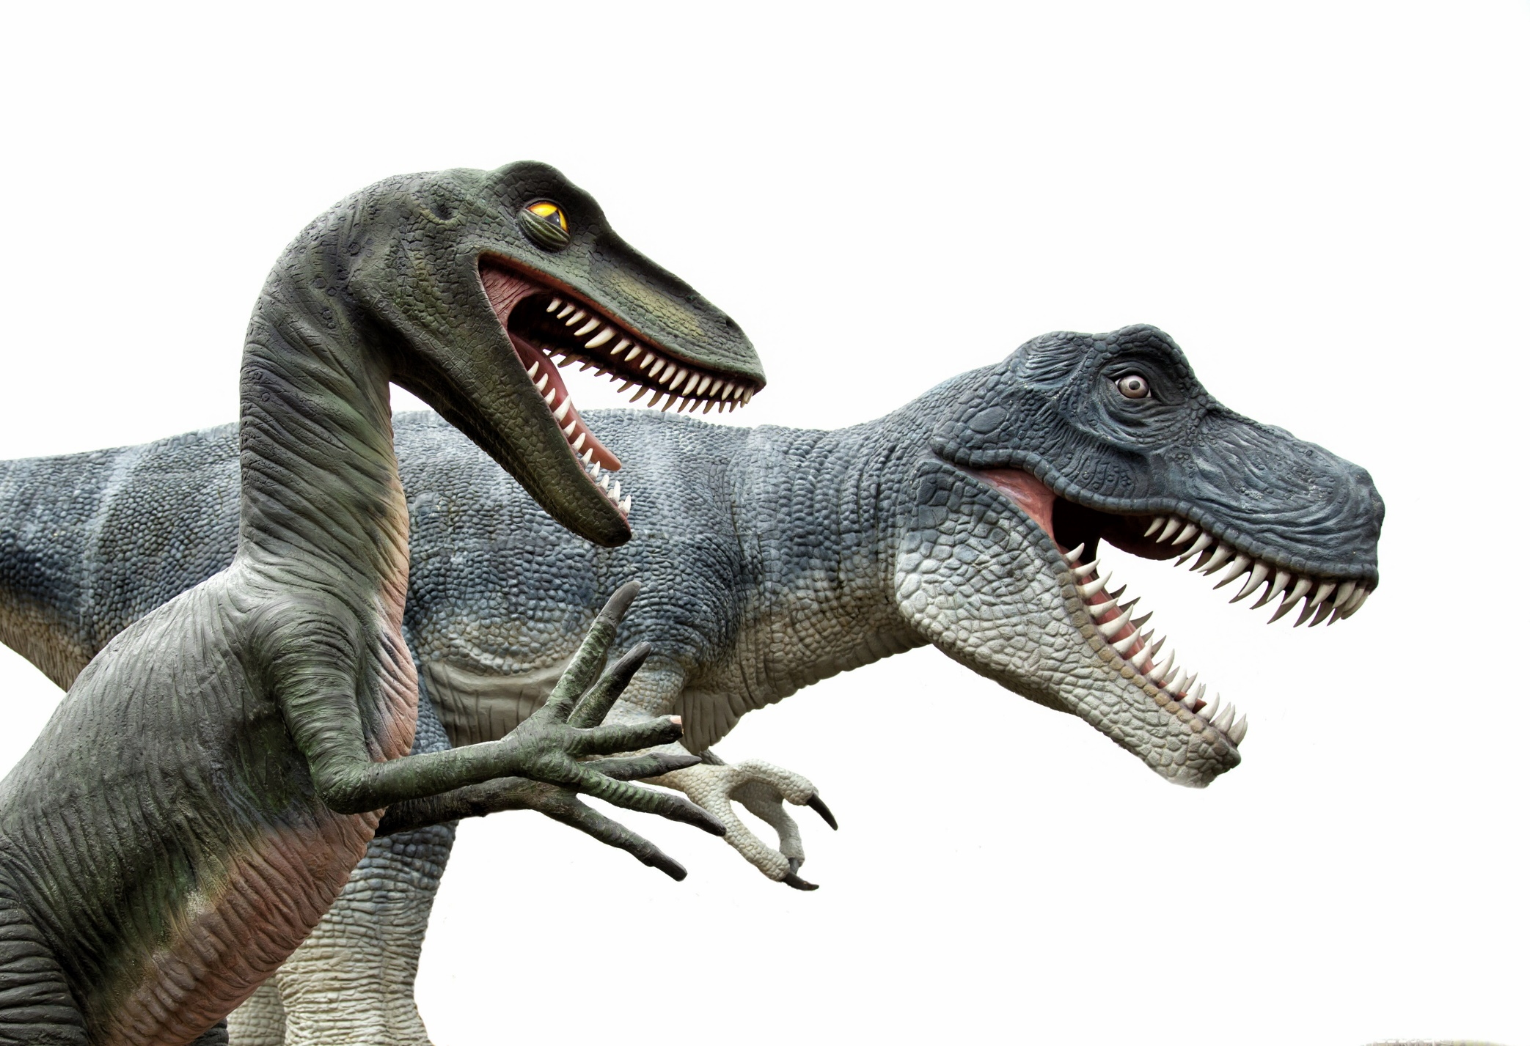
The Black Hills Institute (BHI), located in Hill City, South Dakota, is a geological research facility famous for their fossil finds. In the summer of 1990, Sue Hendrickson, a paleontologist from the BHI decided to keep exploring nearby cliffs while her peers took the truck to town to fix a flat tire. She discovered the first bones of what turned out to be the largest and most complete T-Rex dinosaur ever found, 90% complete.
Scientists believed the remains were quickly covered by water and mud soon after death allowing for the fossilization process to occur. After the bones were plastered and moved to the BHI, they began the cleaning process. Meanwhile, Sue Hendrickson’s reward was having the fossil named after her, Dinosaur Sue.
Because of the value of the T-Rex, a dispute arose over who owned her. The BHI paid the landowner, Maurice William, $5,000 to excavate and remove the bones. Williams claimed that the money paid did not entitle the BHI to own the fossil but only to remove it. Williams was a member of the Sioux tribe, who also claimed the bones belonged to them.
In 1992, the FBI raided the BHI and took the bones to the South Dakota School of Mines and Technology where they stored it until the legal dispute settled. As you can imagine, the people of Hill City were devastated by this news.
The three-year legal battle decreed that Maurice Williams retained ownership, and the remains were returned to him in 1995. Williams then decided to sell Sue and contracted with Sotheby’s to auction her off. People were worried that the fossil might end up in the hands of a private collector and not put on view for the world.
The Field Museum in Chicago was very interested in purchasing Sue, but they did not have the money to invest. After searching for investors who could help them, including Walt Disney Parks, McDonald’s, and many individual donors, they were able to take part in the auction. The auction began its bidding at $500,000, and in less than 10 minutes, Sue was purchased by The Field Museum for $7.6 million dollars. Williams received that amount.
If you want to see Dinosaur Sue today, she is proudly displayed in the main lobby of The Field Museum in Chicago.
27
© Kesler & Wheaton, 2018

Slide 3
Answer the questions below based on the article about creatures from the deep.
COMPREHENSION QUESTIONS:
What is the Black Hills Institute (BHI)? ____________________________________________________________________________________________________________________________________________________________
What did Sue Hendrickson Discover? Highlight your answer in the text. ____________________________________________________________________________________________________________________________________________________________
How was Sue Hendrickson rewarded for her discovery? ____________________________________________________________________________________________________________________________________________________________
What was the legal dispute about over Dinosaur Sue? Underline your answer in the text. ______________________________________________________________________________________________________________________________________________________________________________________________________________________________________________________________________________________________________________________________________________________________________________________________________
How long did the legal battle last? ____________________________________________________________________________________________________________________________________________________________
Who owns Dinosaur Sue now and how did they acquire her? ________________________________________________________________________________________________________________________________________________________________________________________________________________________________________________________________________________________________________________________
Mini-PROJECT: CAREER ESSAY
Research the Black Hills Institute (BHI). Then, write a three-paragraph career research essay that answers the following questions:
What are some of the fossils that they have found?
If you were applying for a job at the BHI what would you apply for?
What education and qualifications would you need to have for that job?
28
© Kesler & Wheaton, 2018

