Slide 1
TEXT ANNOTATION
Use the following directions to annotate each of the texts in this journal.
Draw an arrow pointing at any words, phrases, or paragraphs that help the reader identify something new about the topic presented.
Draw a triangle next to or around any words you do not know.
Then, look up the definition of the word. Write it in the margin or in your notes for future reference.
Draw a star next to any significant quotes. In the margin or in your notes, write WHY you believe the quote is significant to the passage.
Draw a rectangle around the part of the passage that BEST represents the author’s main idea. In the margin or in your notes, explain why.
Draw a circle around any use of figurative language. In the margin or in your notes, explain how the figurative language impacts the passage.
Place a sticky note next to any part of the passage that you do not understand. Write a specific question on the sticky note for class discussion.
Highlight ONE quote that stands out most to you. In the margin or in your notes, explain why this quote made such an impact on you.
Underline any EXAMPLES the author provides about the topic.
Cross out any information that is irrelevant to the topic, if any.
© The SuperHERO Teacher, 2018

Slide 2
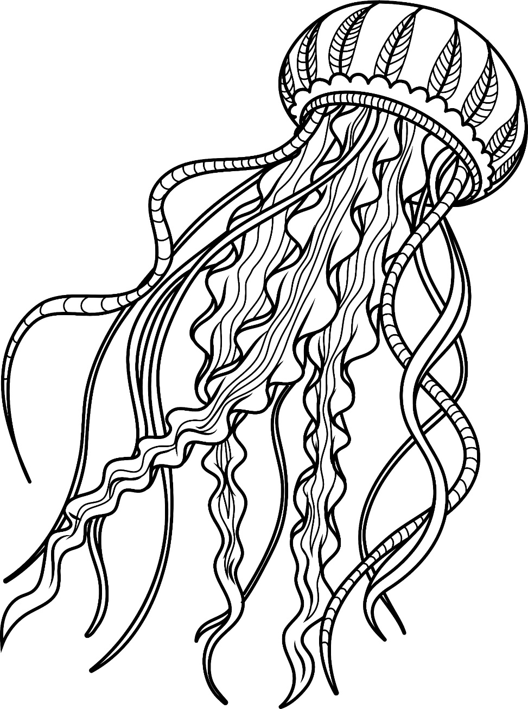
Earth’s surface is two-thirds covered by ocean. Unbelievably, 95% of the oceans have remained unexplored. From the shore, the first 200 meters of water is teaming with life because that’s where sunlight penetrates. Beyond that the light quickly fades away, until at 1,000 meters the water is completely devoid of light and the deep ocean abyss awaits.
You might assume that without sunlight no lifeforms can exist in this pitch-black environment, but you would be wrong. There is an astounding variety of creatures that will boggle your mind. Because the temperatures are so cold, and the pressure is 40-110 times that of Earth, scientists can’t scuba dive there. Instead, they must use sophisticated technologies to explore this vast frontier.
James Cameron, the maker of the movies Avatar and Titanic, is an avid deep-sea explorer. He explored the deepest part of the ocean called the Mariana Trench using a solo submarine called the Challenger Deep. Other types of exploration vehicles are human-occupied vehicles (HOVs) that can transport up to three people to the ocean floor. Autonomous underwater vehicles (AUVs) are robotic vehicles that can collect data from the deep parts of the ocean. These vehicles allow for greater depth in exploration of the deep ocean.
What kinds of creatures can live in this icy cold, pitch-black, crushing environment? The answer to that is thousands of fascinating animals including jellyfish, crustaceans such as shrimp and crabs, corals, fish, and worms. These animals look quite strange compared to their counterparts closer to shore. Their eyes might be huge or even eyes on stalks to capture what little light there is. Others have extremely large mouths and fang-like teeth which are always open, ready to catch food from above. Some have transparent bodies for camouflage.
A surprise discovery in the 1970s led famous deep-sea explorer Robert Ballard, who also discovered the Titanic, to find hydrothermal vents on the ocean floor. Here through cracks in the ocean floor he observed hot steaming water and smoke bubbling up into the cold ocean water. The animals living around these vents were converting energy from the minerals in the water to give them life.
There were many new species found during Ballard’s discovery. The strangest creatures were giant red-tipped tube worms and white worms as tall as your refrigerator. Explorers continue to learn many lessons from visits to the abyss.
25
© Kesler & Wheaton, 2018

Slide 3
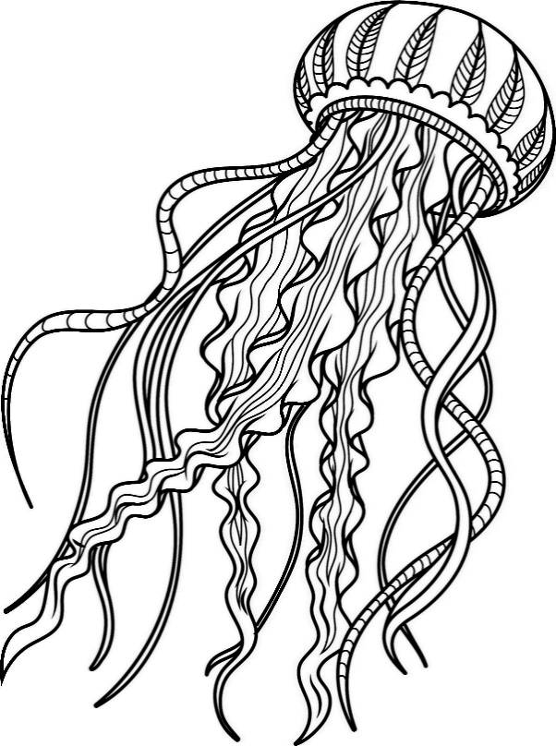
Answer the questions below based on the article about creatures from the deep.
COMPREHENSION QUESTIONS:
What is the deepest part of the ocean called? Highlight your answer in the text. ____________________________________________________________________________________________________________________________________________________________
Why can’t scuba divers dive to the deepest parts of the ocean? Underline your answer in the text. __________________________________________________________________________________________________________________________________________________________________________________________________________________________________________
How do explorers and scientists explore the deep ocean floor? Put a star * next to your answer in the text. __________________________________________________________________________________________________________________________________________________________________________________________________________________________________________
What did Robert Ballard discover in the 1970s? ____________________________________________________________________________________________________________________________________________________________
What kind of animals are found in the harsh environment of the floor of the ocean? ____________________________________________________________________________________________________________________________________________________________
What are some physical differences in these ocean animals? __________________________________________________________________________________________________________________________________________________________________________________________________________________________________________
Mini-PROJECT: INVENT A CREATURE
You are a scientist researching the deep ocean floor. You have discovered a new sea animal. Draw a picture using document provided. Then on your own sheet of notebook paper, explain its habitat, and describe the new species in detail.
Sketch and name the new species
Determine its habitat, diet, and similar species
Explain all of the above in a three-paragraph essay
26
© Kesler & Wheaton, 2018

Slide 4
Describe the creature’s habitat, diet, and similar species. ________________________________________________________________________________________________________________________________________________________________________________________________________________________________________________________________________________________________________________________________________________________________________________________________________________________________________________________________________________________________________________________________________________________________________________________________________________________________________________________________________________________________________________________________________________________________________________________________________________________________________________________________________________________________________________________________________________
26

